Slide 1
Real-Time E-Commerce User Analytics and Recommendation System
MENTOR: Dr N. Shirisha, Assoc.Prof.
BATCH NO: 8
TEAM MEMBERS:
Krithik Reddy – 2320030234 B Nishanth – 2320030119 Sai Bharadwaj – 2320030482

Slide 2
Table of contents
REVIEW 2 COMMENTS ADDRESSED
MODULE WISE IMPLEMENTATION
COMPARISION AND DISCUSSION
RESULTS
CONCLUSION
FUTURE DIRECTION
REFERENCES

Slide 3
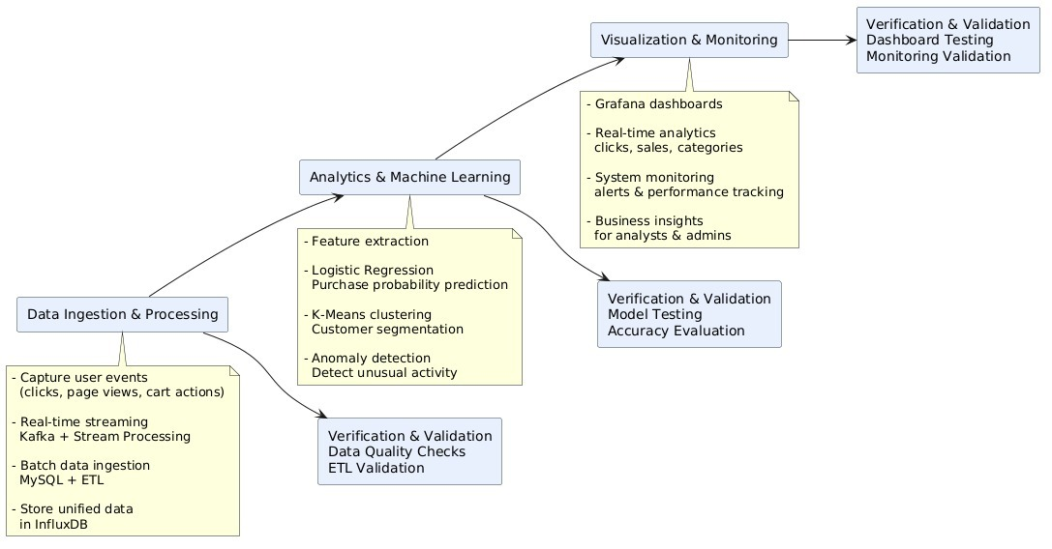
REVIEW 2 COMMENTS ADDRESSED
Redesigned the module and divided the tasks according to the module

Slide 4
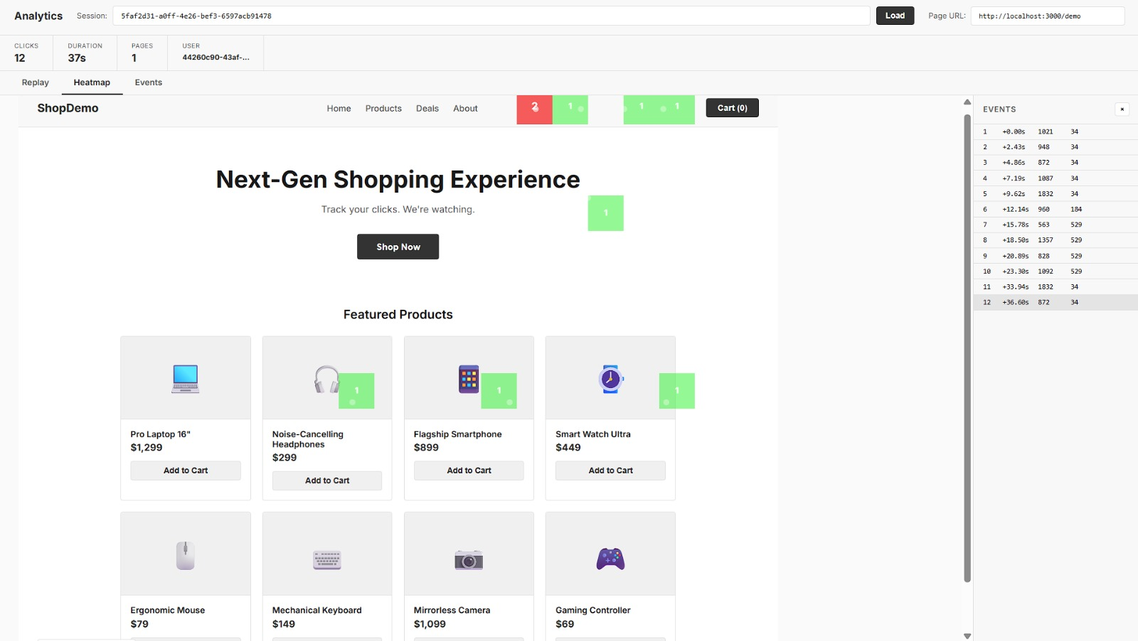
DATA INGESTION MODULE

Slide 5
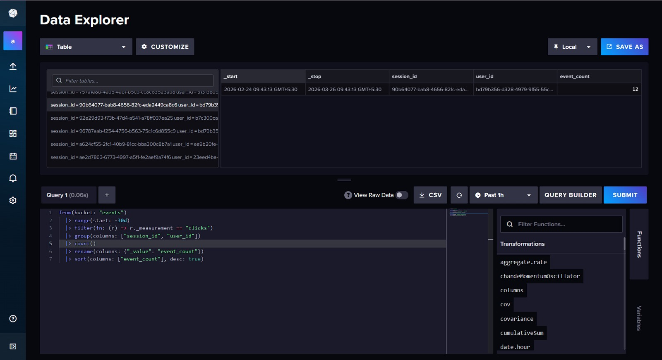
DATA INGESTION MODULE

Slide 6
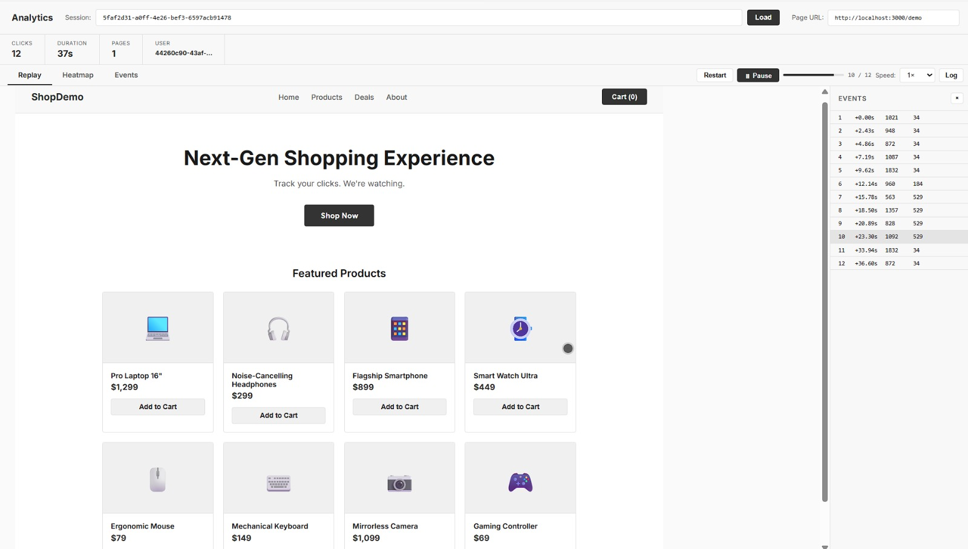
DATA ANALYTICS MODULE

Slide 7
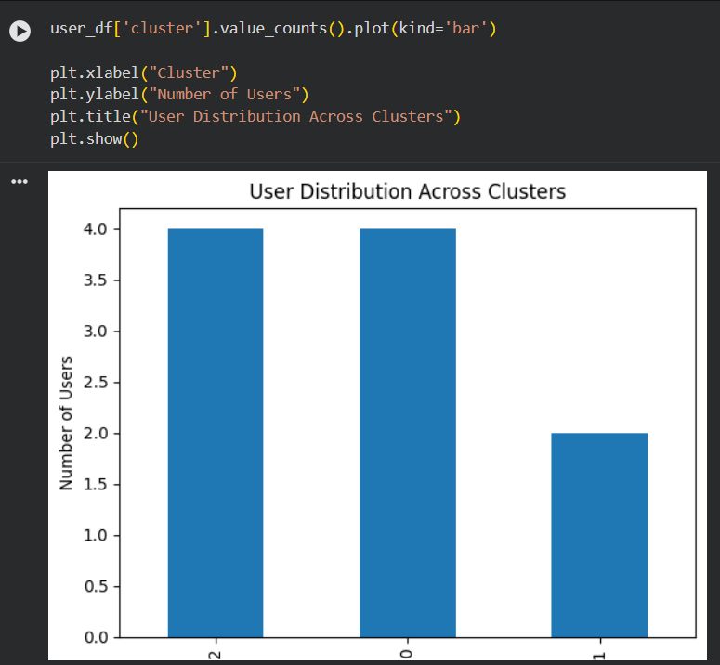
DATA ANALYTICS MODULE

Slide 8
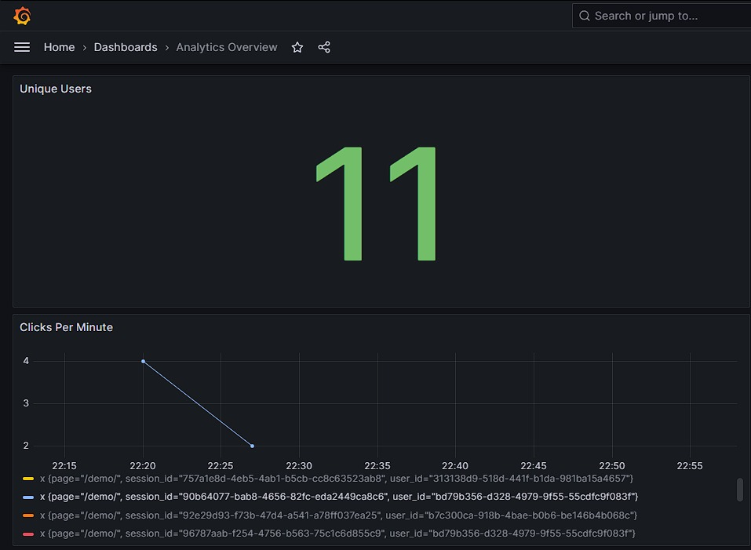
VISUALIZATION MODULE

Slide 9
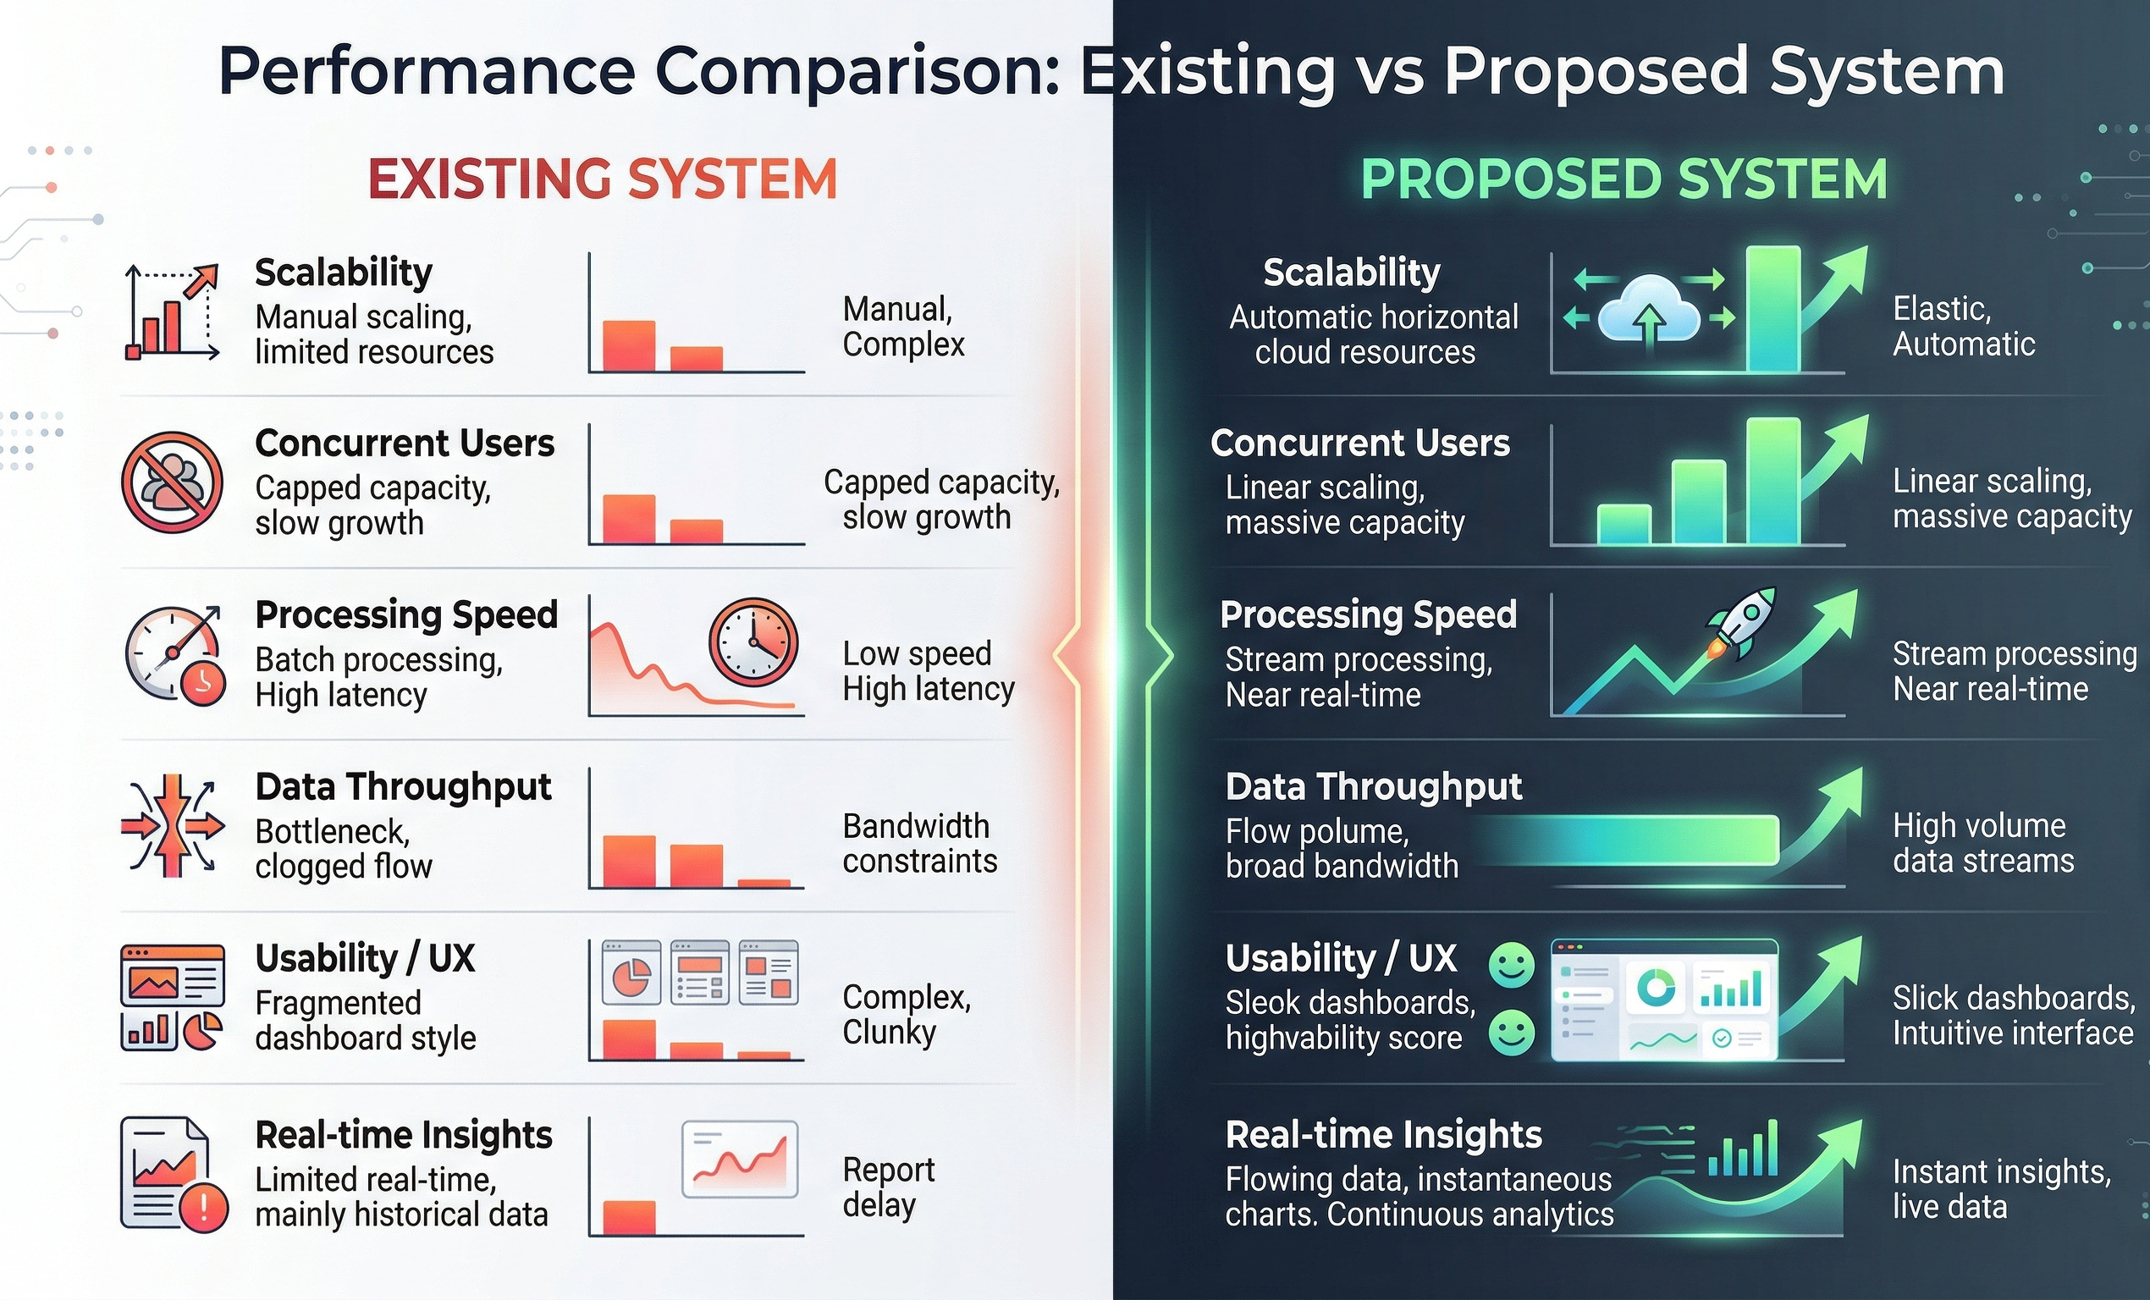
Comparison EXISTING VS PROPOSEd

Slide 10
RESULTS
1. Real-Time Data Processing Performance
Successfully handled user clicks, purchases, sessions events
System maintained stable throughput under continuous load
Result: Near real-time analytics pipeline achieved
3. Machine Learning Model Performance
Implemented:
Linear Regression → Sales prediction
KNN → User segmentation
Performance Metrics:
Linear Regression Accuracy (R² Score): 0.82
KNN Classification Accuracy: 85%
Result: Reliable predictive insights for decision-making
2.User Behavior Analytics
Identified top user interaction patterns:
Peak activity time: Evening (6 PM – 10 PM)
Most viewed category: Electronics
Session tracking enabled accurate user journey mapping
Result: Improved understanding of customer behavior
4.Visualization & Dashboard Insights
Using Grafana dashboards:
Real-time sales trends visualized
Live user activity monitoring
Product performance comparison charts
Result: Easy interpretation of complex data

Slide 11
FUTURE DIRECTION
1. Advanced AI/ML Integration
Implement Deep Learning models (LSTM, Transformers) for better demand forecasting
Add Recommendation Systems (collaborative + content-based filtering) More personalized user experience and higher conversions
2. Predictive & Prescriptive Analytics
Move from descriptive → predictive + prescriptive analytics
Suggest optimal pricing, inventory levels, and marketing strategies Data-driven automated decision-making
3. Real-Time Fraud Detection
Integrate anomaly detection models for fraudulent transactions
Use streaming analysis with Apache Flink for instant alerts improved security and trust
4. Scalability Enhancements
Deploy using cloud-native architecture (AWS / Azure / GCP)
Use containerization (Docker + Kubernetes) for auto-scaling Handle millions of concurrent users

Slide 12
REFERENCES
AI-Driven Recommendations Sabina-Cristiana Necula LINK
The Application of Artificial Intelligence in Electronic Commerce Xia Song et al. LINK
Big Data Analytics in E-Commerce Samuel Fosso Wamba LINK
The Increasing Importance of AI Applications in E-Commerce A.A. Nimbalkar, A.T. Berad LINK
User-Centric Internal Tools in E-Commerce Xue Song LINK
Grafana Documentation LINK
Python Documentation LINK

Slide 13


